Slide 1


Volatile Visitor
Healthcare Workplace Violence Tabletop Toolkit |
Healthcare Coalition Exercise Toolkit Series
Healthcare Workplace Violence Tabletop Exercise
Healthcare Workplace Violence Tabletop Toolkit | Healthcare Coalition Exercise Toolkit Series

Slide 2

Welcome and Introductions
Facilitator introduction
Participant quick introductions (optional)
Session overview
Healthcare Workplace Violence Tabletop Toolkit | Healthcare Coalition Exercise Toolkit Series

Slide 3
Exercise Overview and Structure
Discussion-based tabletop
3 progressive modules
Focus on real-world response
No-fault environment
Healthcare Workplace Violence Tabletop Toolkit | Healthcare Coalition Exercise Toolkit Series

Slide 4
Module Overview
Module 1: Recognition
Module 2: Escalation
Module 3: Recovery
Healthcare Workplace Violence Tabletop Toolkit | Healthcare Coalition Exercise Toolkit Series

Slide 5
Key Risk Insight
Workplace violence rarely starts as a threat—
it escalates from unmanaged agitation.
Healthcare Workplace Violence Tabletop Toolkit | Healthcare Coalition Exercise Toolkit Series

Slide 6
Module 1: Initial Confrontation
Tampa Bay Health & Medical Preparedness Coalition (TBHMPC)

Slide 7
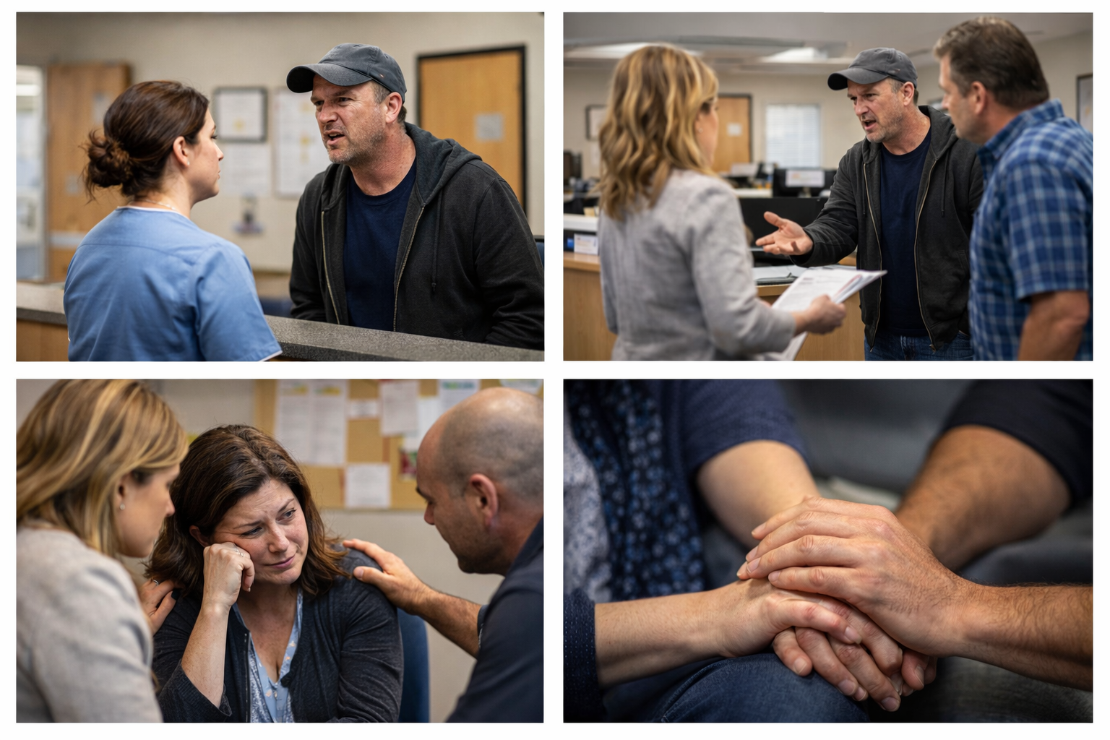
Module 1: Initial Confrontation
Scenario
Visitor upset about care and wait times
Tension begins to build
Healthcare Workplace Violence Tabletop Toolkit | Healthcare Coalition Exercise Toolkit Series
Notes:
FACILITATOR CUE: Focus on what staff observe, say, and do in the first 1–2 minutes.

Slide 8
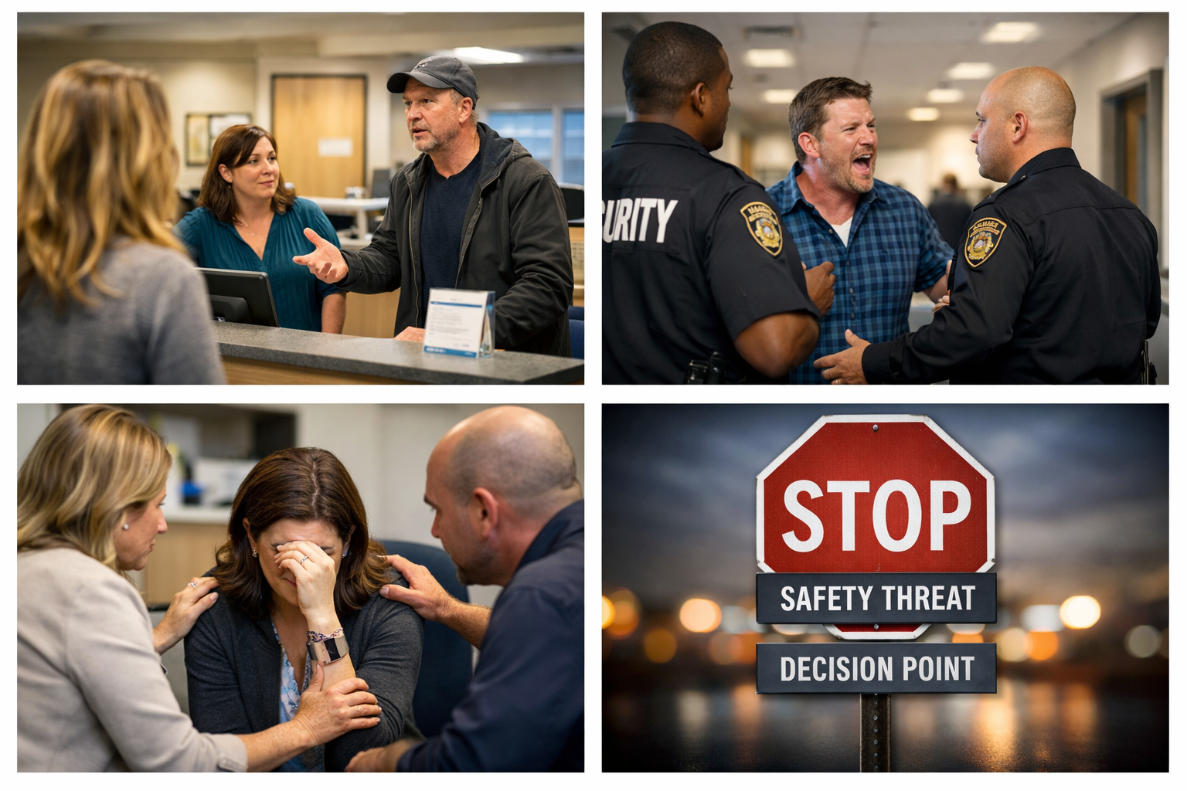
Module 1: Initial Confrontation
Discussion Prompts
Early recognition
Initial engagement
Immediate response
Communication
Healthcare Workplace Violence Tabletop Toolkit | Healthcare Coalition Exercise Toolkit Series

Slide 9
Module 2: Escalation
Tampa Bay Health & Medical Preparedness Coalition (TBHMPC)

Slide 10
Module 2: Escalation
Scenario
Behavior escalates
Potential threat develops
Decision Point
When does this become a safety threat?
Healthcare Workplace Violence Tabletop Toolkit | Healthcare Coalition Exercise Toolkit Series

Slide 11
Module 2: Escalation
Discussion Prompts
Escalation indicators
Safety actions
Operational impact
Security / law enforcement
Healthcare Workplace Violence Tabletop Toolkit | Healthcare Coalition Exercise Toolkit Series

Slide 12
Module 3: Recovery
Tampa Bay Health & Medical Preparedness Coalition (TBHMPC)

Slide 13
Module 3: Recovery
Scenario
Incident resolved
Staff and patients impacted
Healthcare Workplace Violence Tabletop Toolkit | Healthcare Coalition Exercise Toolkit Series

Slide 14
Module 3: Recovery
Discussion Prompts
Immediate actions
Staff support
Debriefing
Long-term improvements
Often Overlooked
Psychological impact can be long-lasting.
Healthcare Workplace Violence Tabletop Toolkit | Healthcare Coalition Exercise Toolkit Series

Slide 15
Hot Wash and After-Action Review
Tampa Bay Health & Medical Preparedness Coalition (TBHMPC)

Slide 16
Hot Wash and After-Action Review
Key Questions
What went well?
What needs improvement?
What actions are needed?
Healthcare Workplace Violence Tabletop Toolkit | Healthcare Coalition Exercise Toolkit Series

Slide 17
Hot Wash and After-Action Review
Action Planning
List Actions needed to be taken to address identified gaps.
Identify the Responsible Party
Set a Timeline to implements identified improvements
Healthcare Workplace Violence Tabletop Toolkit | Healthcare Coalition Exercise Toolkit Series

Slide 18
Hot Wash and After-Action Review
Closing
Key takeaway: early recognition + coordinated response
Healthcare Workplace Violence Tabletop Toolkit | Healthcare Coalition Exercise Toolkit Series

Slide 19
Preparedness | Response | Recovery
Tampa Bay Health & Medical Preparedness Coalition (TBHMPC)

